Slide 1
Presentation:
Coherent Asset Allocation and Diversification in the Presence of Stress Events
This is strictly confidential and may not be reproduced or distributed in whole or in part without the prior written consent of MKP® Capital Management, L.L.C. (“MKP Capital”). This is not an offer or solicitation with respect to the purchase or sale of any security. This document is not intended to constitute legal, tax, accounting or investment advice. The information is provided for discussion purposes only, is only a summary of key information, is not complete, is intended only for the person to whom it has been provided by MKP Capital.

Slide 2
Introduction & Motivation
From Markowitz framework, ‘risk’ is variance; and codependence is correlation
‘Normal Market’ assumption may not be true when extreme events happen: tail behavior(different behavior with same variance), correlation to be +1/-1 thus diversification fails

Slide 3
Introduction & Motivation
‘Six-Sigma events’ occur with much higher frequency and without any recognizable ‘signature’, which means there is no priori information to observe
What we do here is to complement the traditional approach (based on correlations, covariance and copula), with a causality based framework

Slide 4
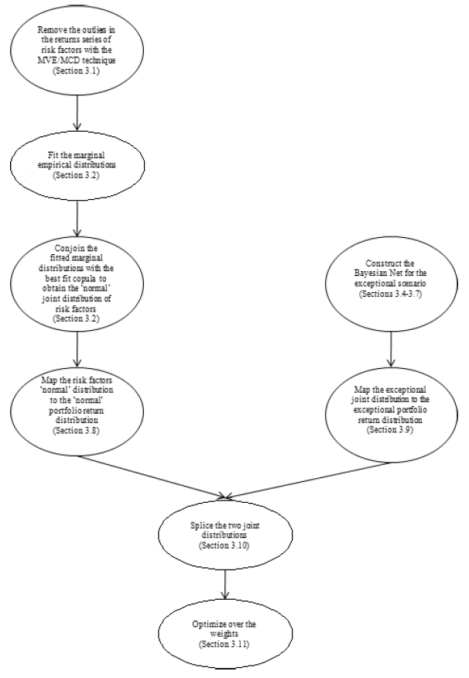
Outline of the approach
Divide data into two Parts:
1.Body data use t-distribution and student t-copula to model(left)
2.Extreme parts use discrete Bayesian network to model(right)
Six steps:
1. Clean data
2. Model for body part
3. Model for extreme part
4. Map return function & get P&L DF
5. Select utility function
6. Optimize for the utility function & get portfolio weights

Slide 5
Outline of the approach
Step1 :Clean data
(1) Remove extreme data points
Use MVE approach(minimum volume ellipsoid) to pick out the outliers
Volume of smallest ellipsoid and determinant of covariance matrix decrease during this process

Slide 6
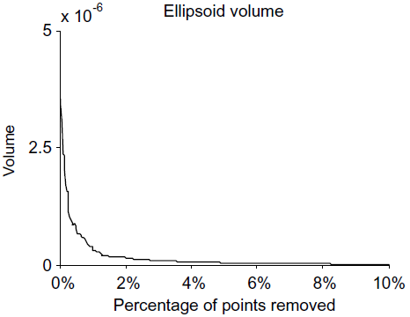
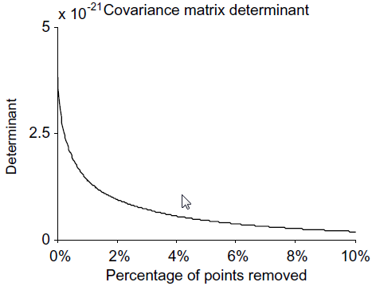
Figure

Slide 7
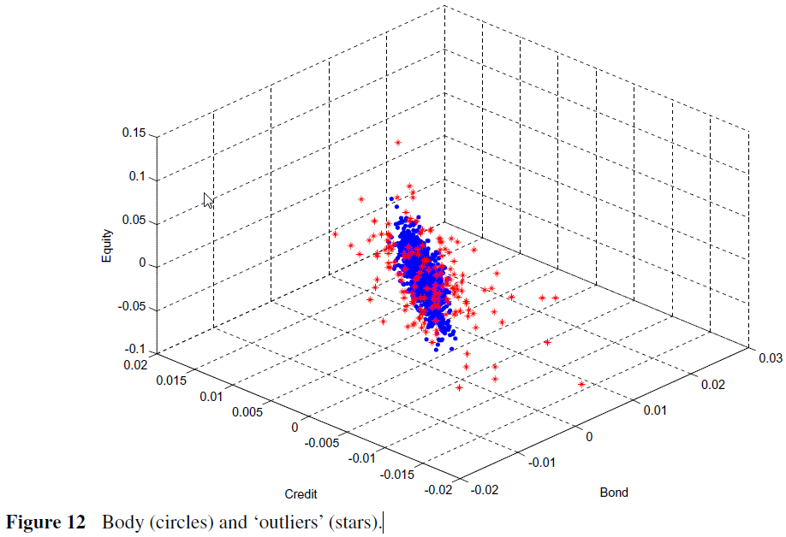
Figure

Slide 8
Outline of the approach
Step 2: Model for body part
(2) Constructing the Marginal Distribution of the ‘Normal’ Risk Factors
t- Student or normal
(3) Constructing a Joint Distribution of ‘Normal’ Risk Factors(Copula)
Employ ‘Inference from Marginal’ Method to estimate t-student copula here
Assess GOF(goodness of fit) for the estimated copula

Slide 9
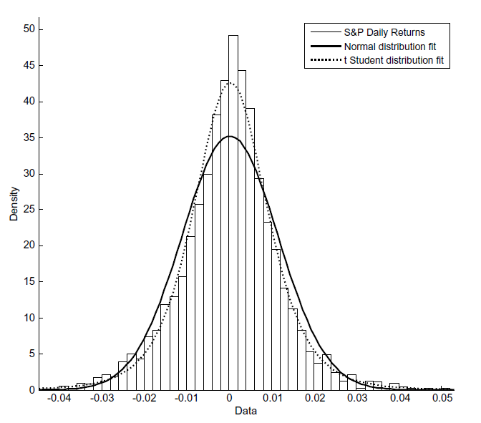
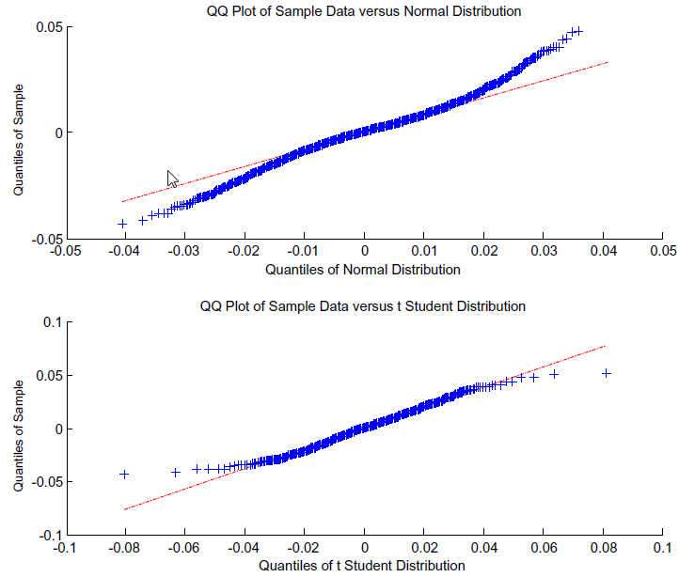
Figure

Slide 10
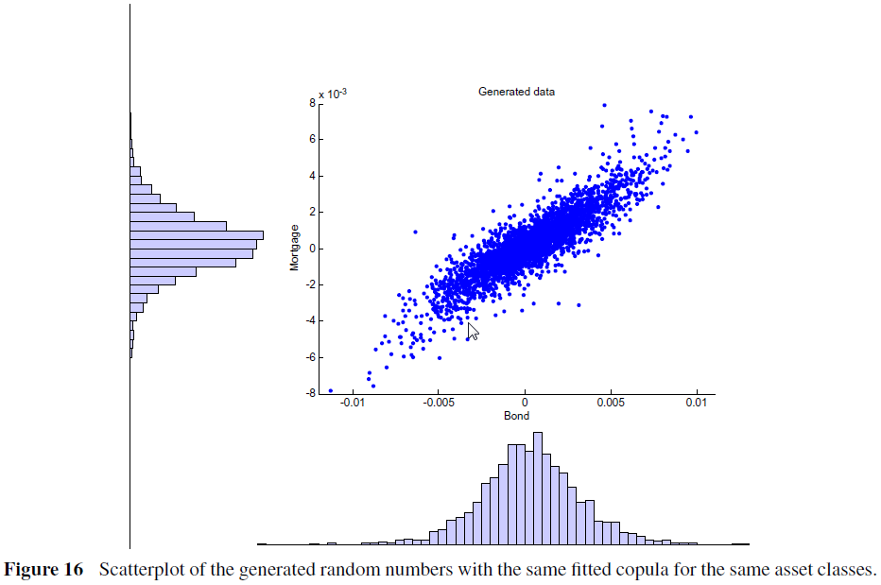
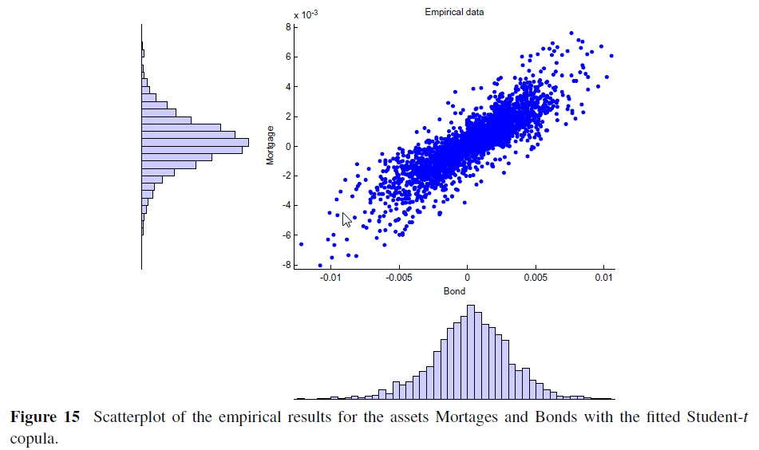
Figure
Empirical results for the fitted student-t copula
Generated random numbers distribution based on empirical copula

Slide 11
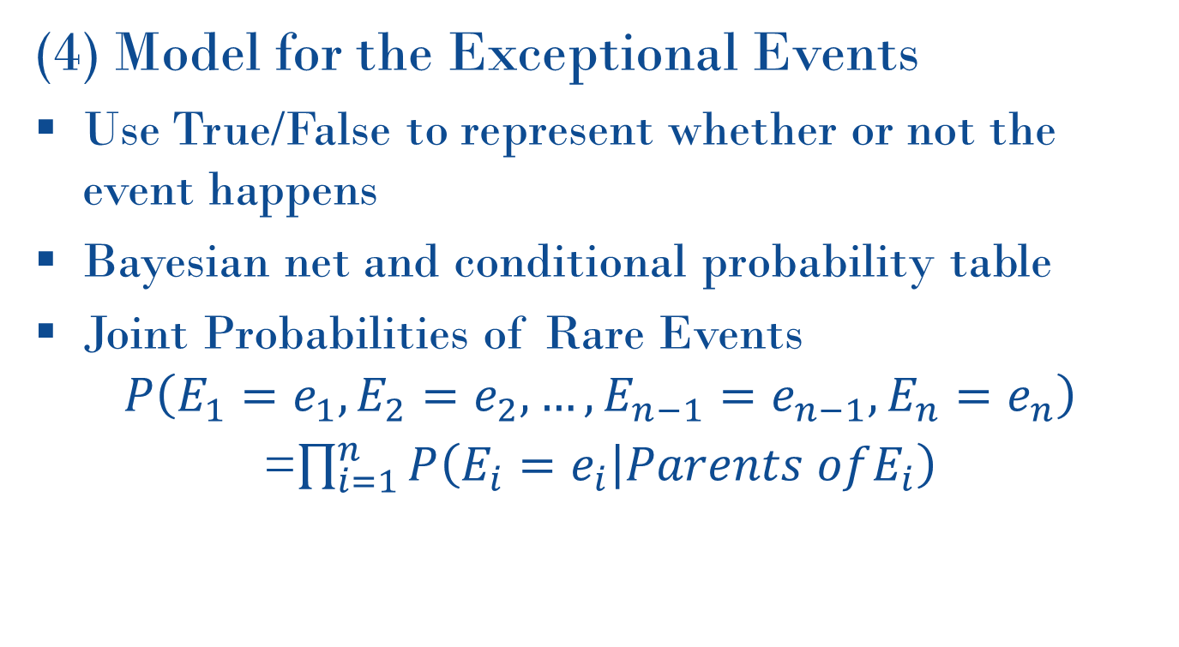
Outline of the approach
Step 3: Model for extreme part
(4) Model for the Exceptional Events
Use True/False to represent whether or not the event happens
Bayesian net and conditional probability table
Joint Probabilities of Rare Events
$$P\left(E_{1}=e_{1},E_{2}=e_{2},…,E_{n−1}=e_{n−1},E_{n}=e_{n}\right)$$
=$\prod_{i=1}^{n}{P\left(E_{i}=e_{i} | Parents ofE_{i}\right)}$

Slide 12
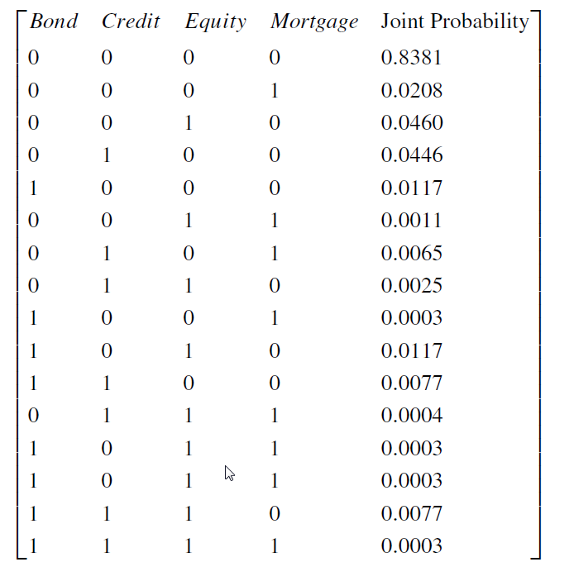
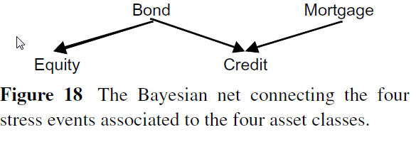
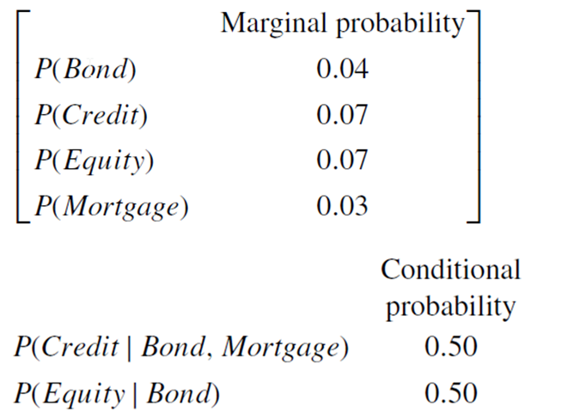
Figure
Joint probability table

Slide 13
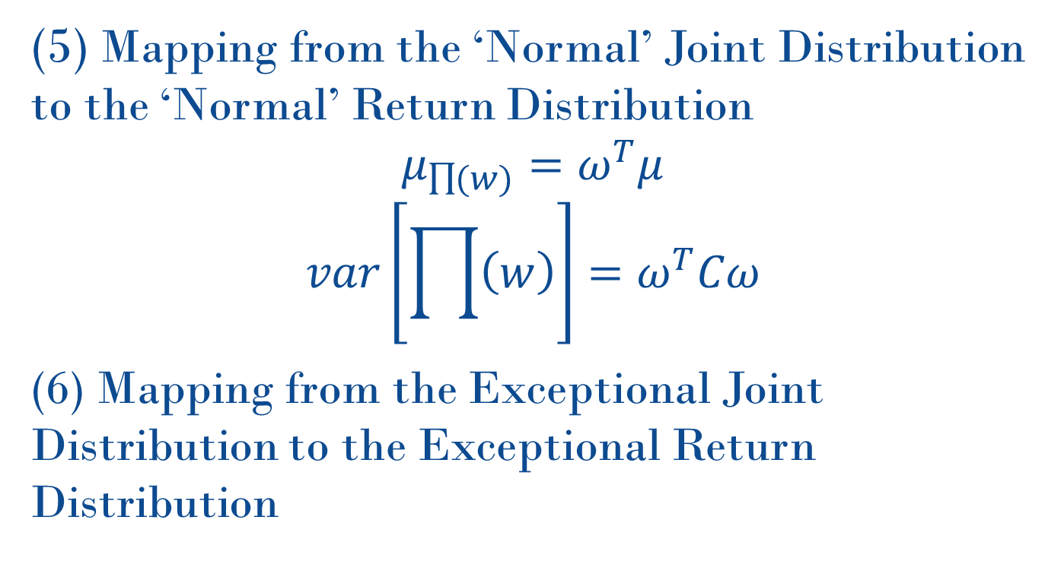
Outline of the approach
Step 4 : Map return function
(5) Mapping from the ‘Normal’ Joint Distribution to the ‘Normal’ Return Distribution
$$μ_{\prod{(w)}}=ω^{T}μ$$
$$var\left[\prod{\left(w\right)}\right]=ω^{T}Cω$$
(6) Mapping from the Exceptional Joint Distribution to the Exceptional Return Distribution

Slide 14

Outline of the approach
Whole data
Extreme event
Weight k
$$p_{1}$$
𝑝_1
$$p_{2}$$
𝑝_2
Normal data
Weight (1-k)
Return x
$$p_{2^{n}−1}$$
𝑝_(2^𝑛−1)
…
Note:
k is your subjective parameter!
Intuitively, k is the
$$1−p_{0}$$

Slide 15
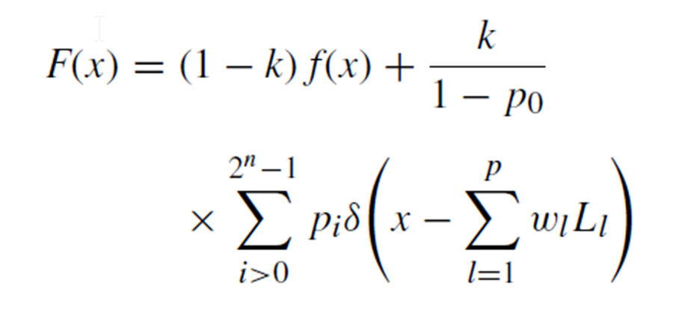
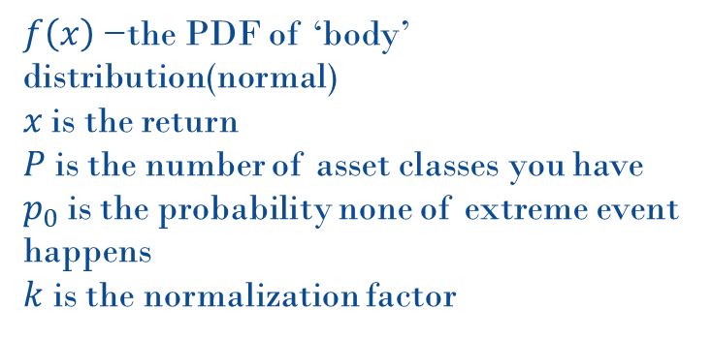
Outline of the approach
Step 4: Density function
(7) Get probability density function of P&L distribution
$f\left(x\right)$ −the PDF of ‘body’ distribution(normal)
$x$ is the return
$P$ is the number of asset classes you have
$p_{0}$ is the probability none of extreme event happens
$k$ is the normalization factor

Slide 16
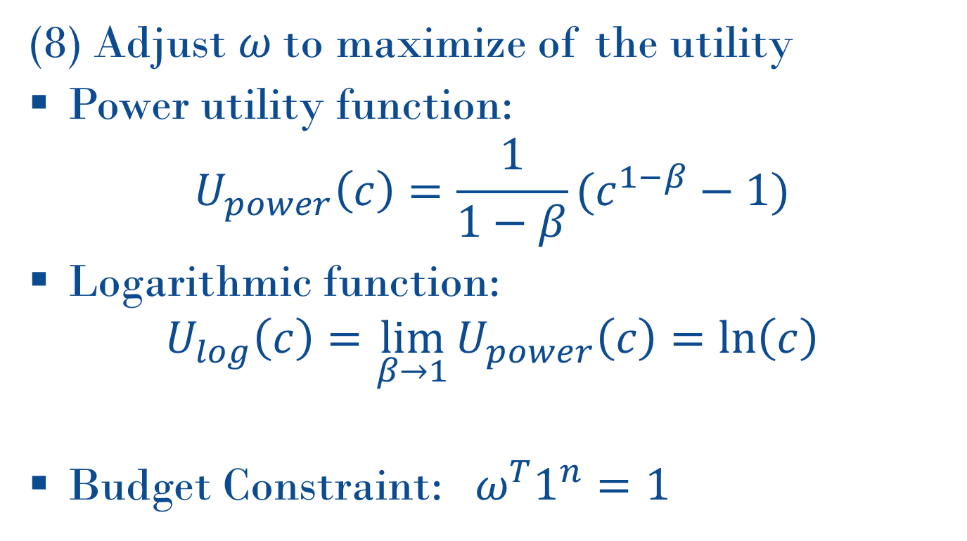
Outline of the approach
Step 5: Select utility function
(8) Adjust $ω$to maximize of the utility
Power utility function:
$$U_{power}\left(c\right)=\frac{1}{1−β}(c^{1−β}−1)$$
Logarithmic function:
$$U_{log}\left(c\right)=\lim_{β→1}{U_{power}\left(c\right)}=\ln\left(c\right)$$
Budget Constraint:${ ω}^{T}1^{n}=1$

Slide 17
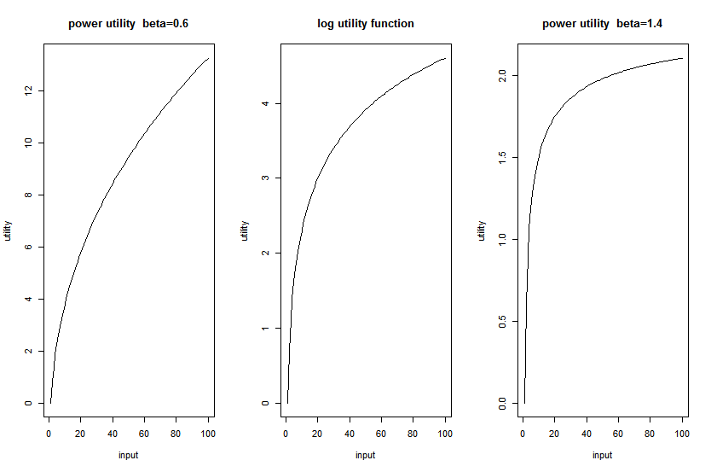
Figure

Slide 18
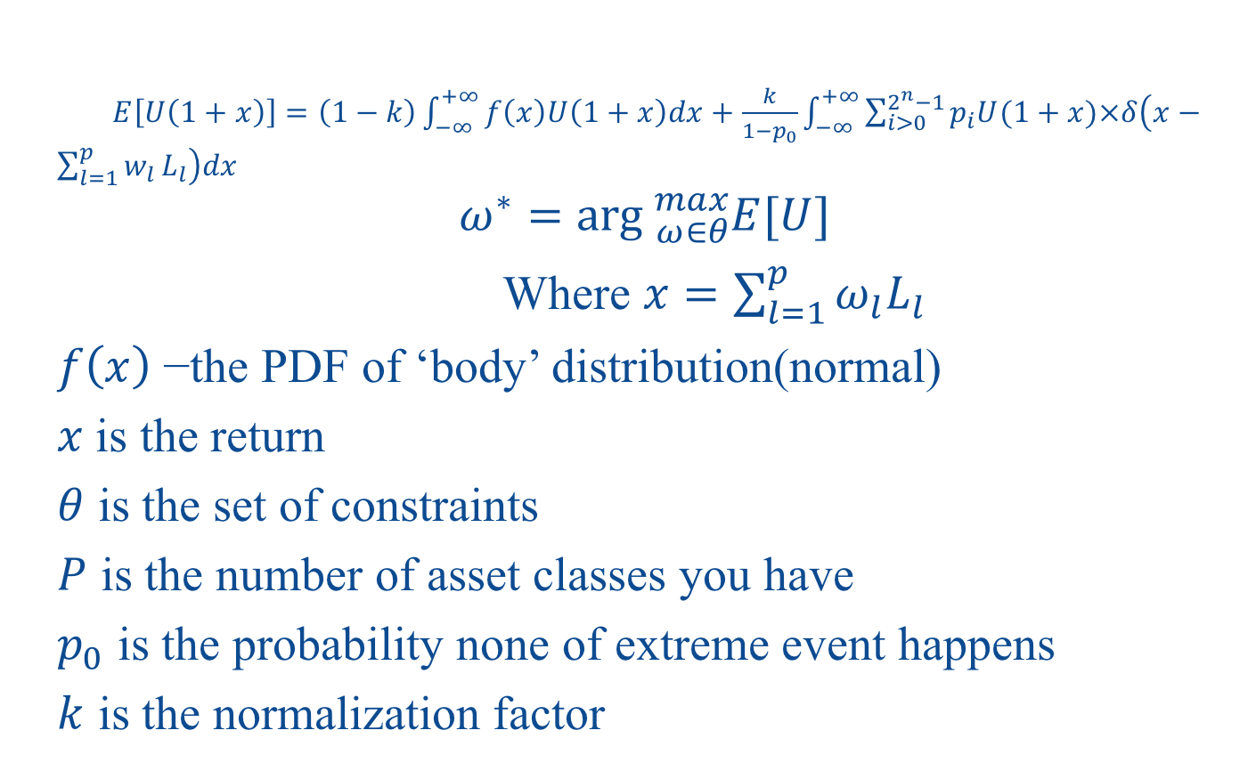
Outline of the approach
Step 6: Optimize for the utility function
$E\left[U\left(1+x\right)\right]=\left(1−k\right)\int_{−∞}^{+∞}{f\left(x\right)U\left(1+x\right)dx}+\frac{k}{1−p_{0}}\int_{−∞}^{+∞}{\sum_{i>0}^{2^{n}−1}{p_{i}U(1+x)×δ\left(x−\sum_{l=1}^{p}{w_{l}}L_{l}\right)dx}}$
$$ω^{∗}=\arg{{}_{ω∈θ}^{max}{E[U]}}$$
Where $x=\sum_{l=1}^{p}{ω_{l}L_{l}}$
$f\left(x\right)$ −the PDF of ‘body’ distribution(normal)
$x$ is the return
$θ$ is the set of constraints
$P$ is the number of asset classes you have
$p_{0}$ is the probability none of extreme event happens
$k$ is the normalization factor

Slide 19
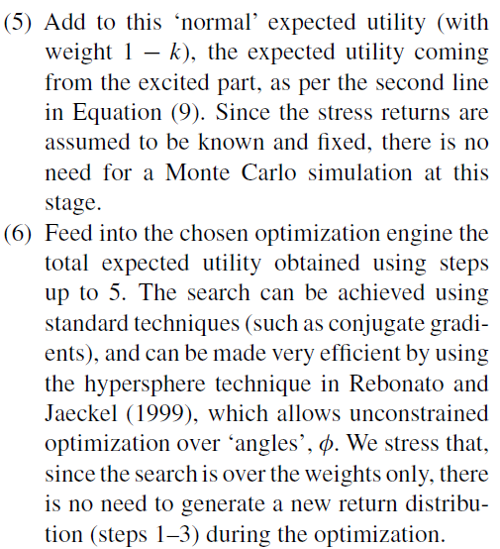
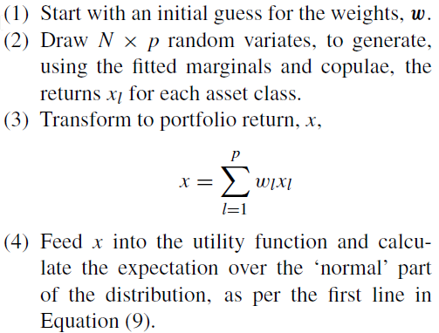
Outline of the approach

Slide 20
Example 1
Implementation of Work-out example
Four asset classes:
BarCap US Treasury Index(bond)
BarCap US Credit Index(credit)
the S&P 500(equity, long-only)
the BarCap US MBS Index(mortgage)
(The data set consisted of 3351 x 4 data points, covering the period Feb3 1997 to Jun 30 2010)
After using MVE and MCD methods,167(5%) data was excluded
Used t-Student distribution to model for the truncated data

Slide 21
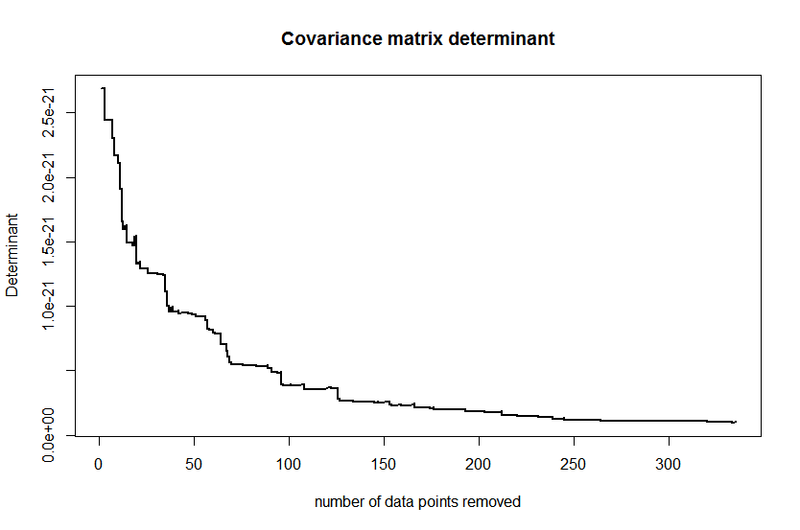
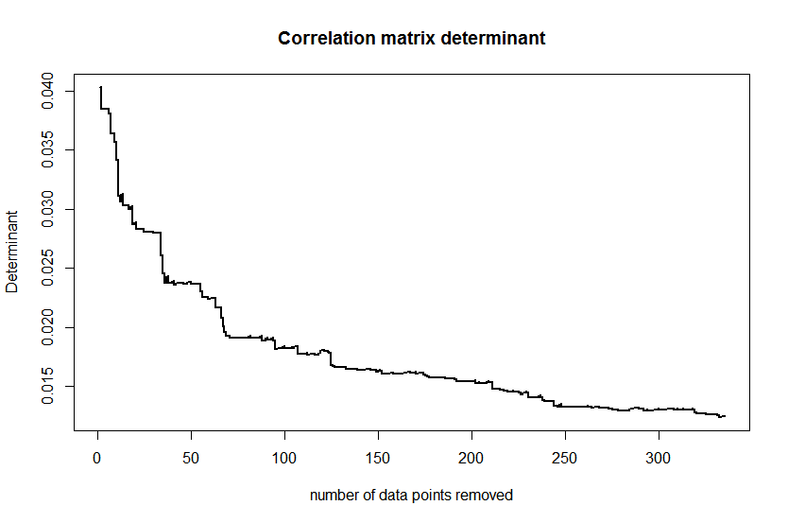
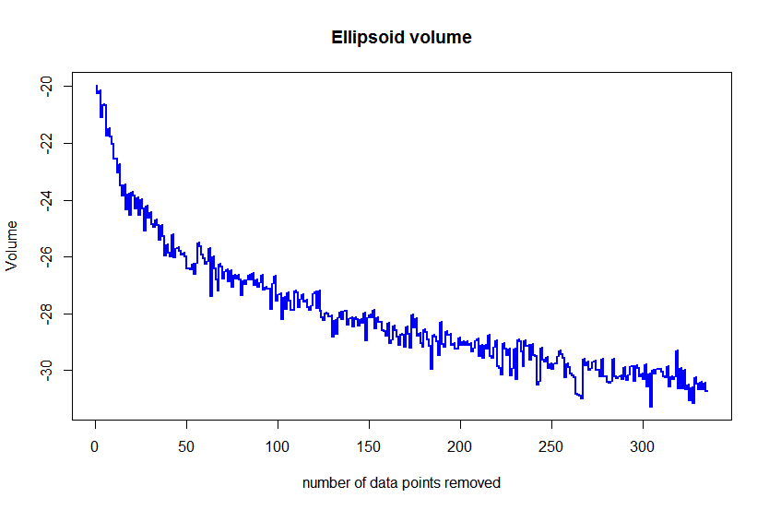
Example 1
Clean data, remove extreme data

Slide 22
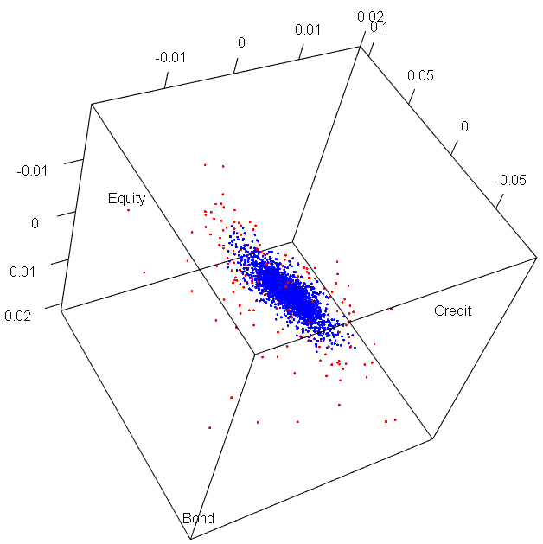
Example 1
Clean data, remove extreme data
3D plot of data points(blue: data-body; red: ‘outliers’)

Slide 23
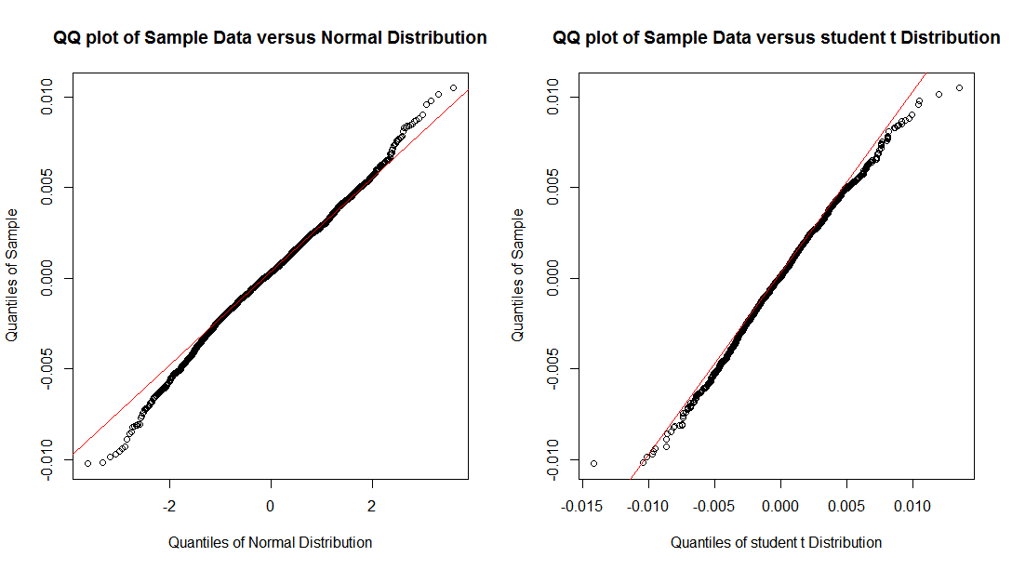
Example 1
Model for body part(marginal )

Slide 24
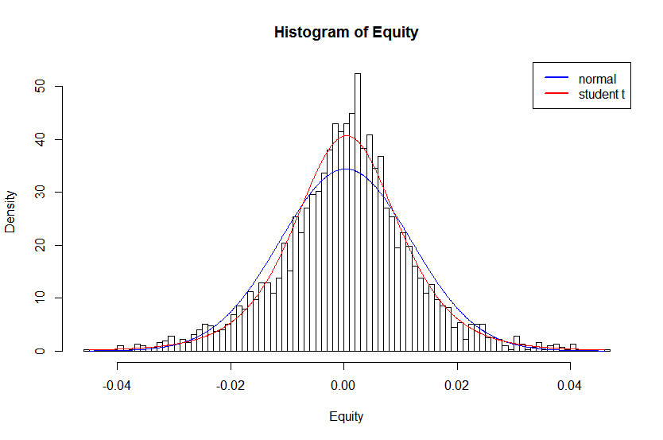
Example 1
Model for body part(marginal )

Slide 25
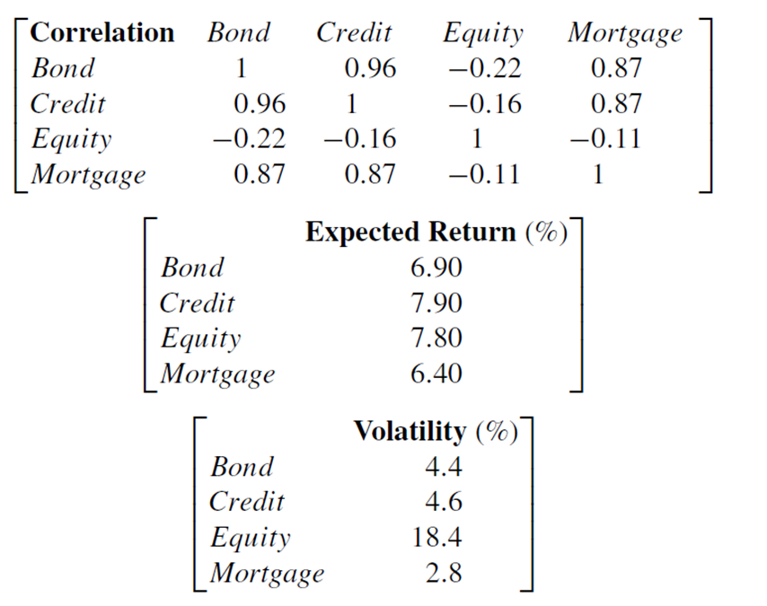
Example 1
Body part: volatility, correlation and return table

Slide 26
Example 1
estimate t copula & assess goodness of fit
I compared

Slide 27
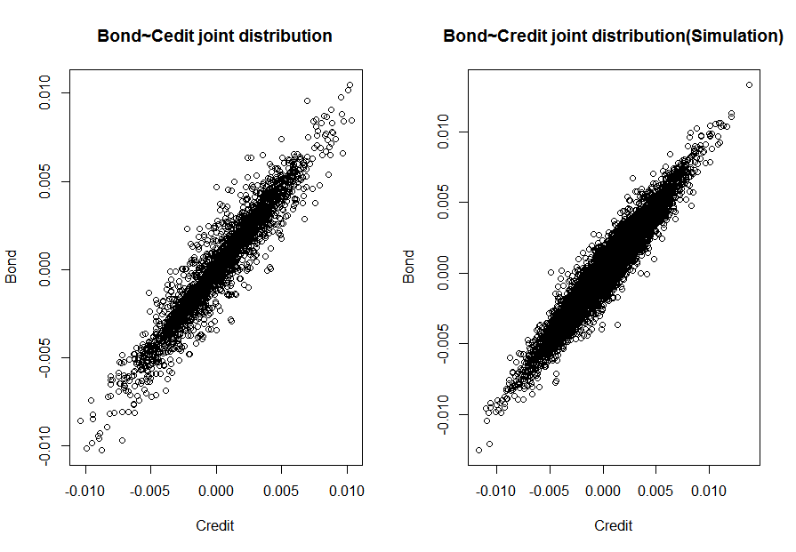
Example 1
Model for body part( joint, simulation result)

Slide 28
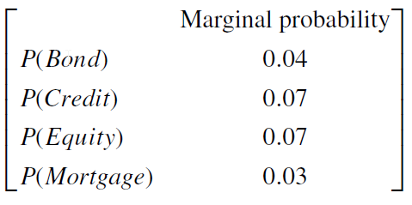
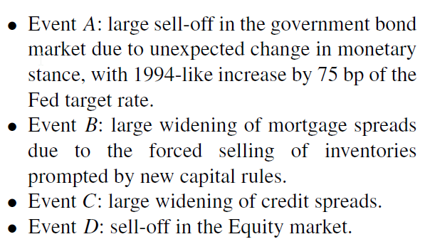
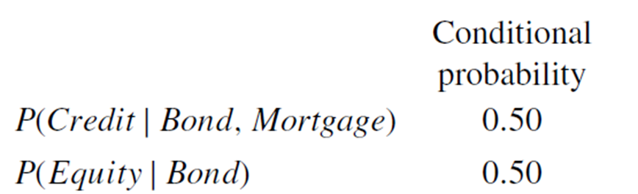
Example 1
Model for extreme part

Slide 29
Example 1
Joint probability table for extreme part

Slide 30
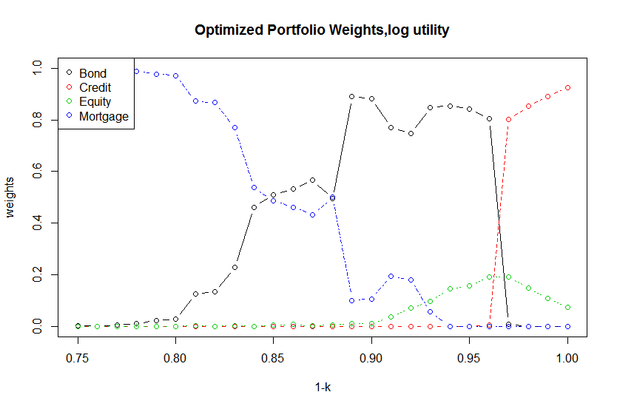
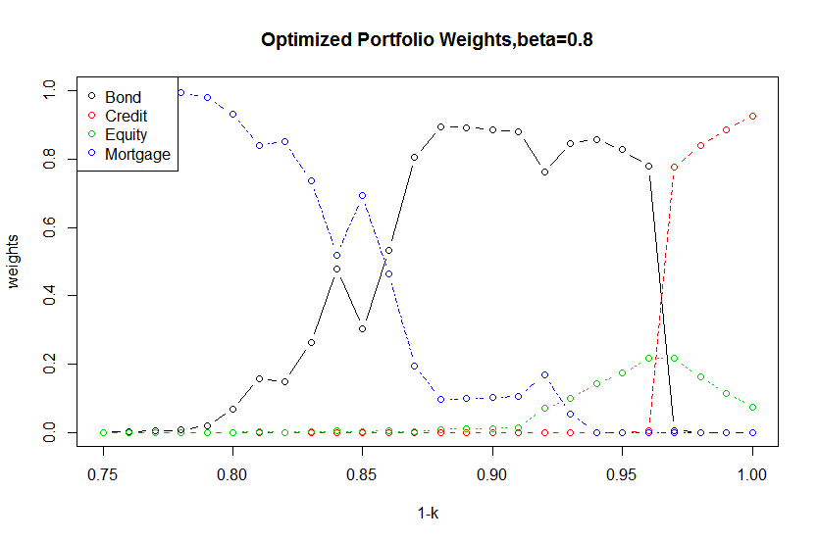
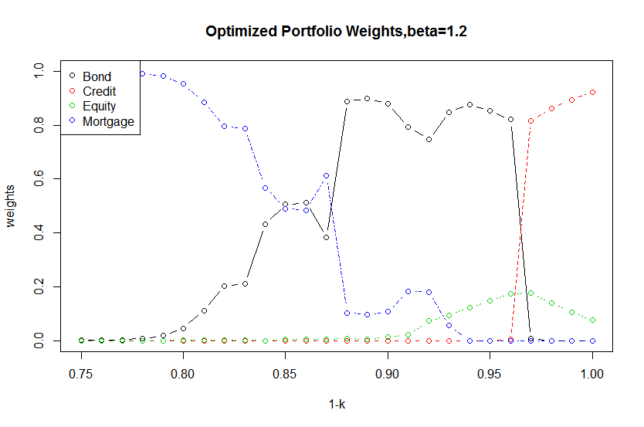
Example 1
Result:
Here, we set the annualized extreme loss of each kind portfolio to be:-18%(Bond),-53%(Credit),-33%(Equity),-14%(Mortgage).

Slide 31
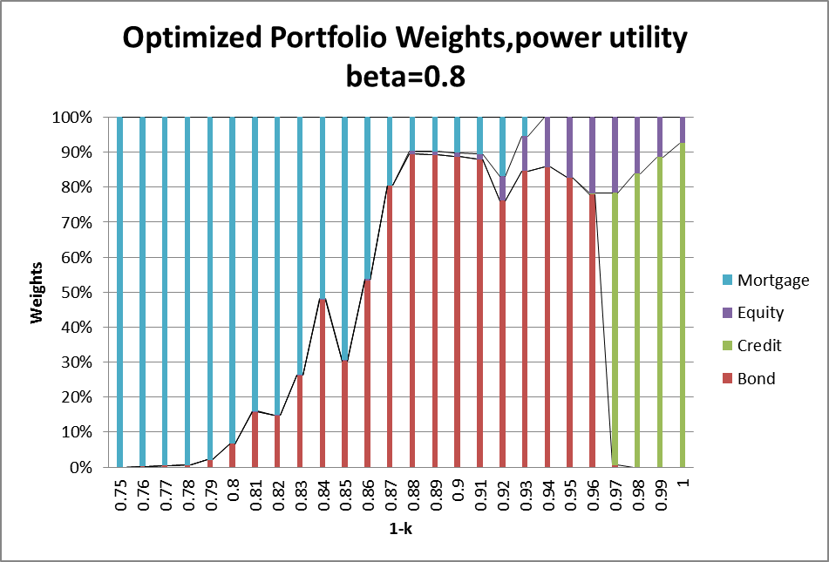
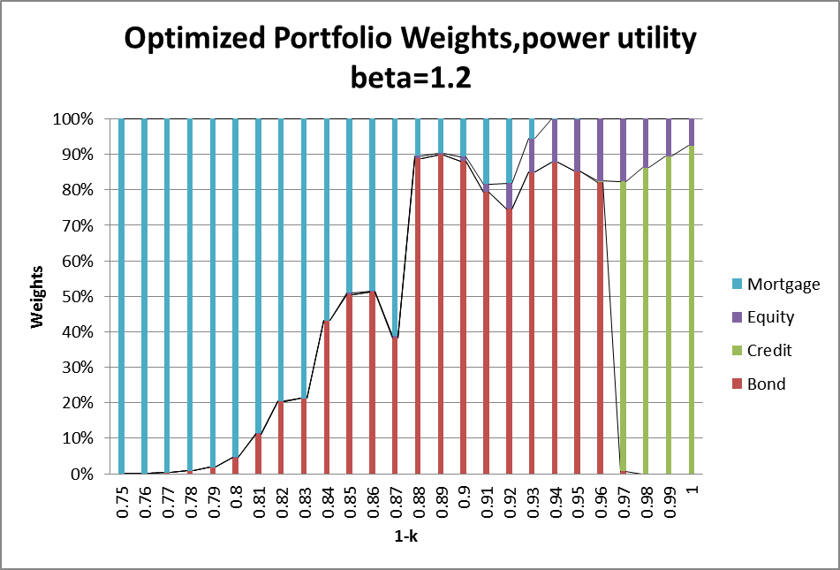
Example 1
Result:

Slide 32
Example 2
A more complicated Bayesian net
Three asset classes:
JPMorgan Sterling HY Summary Total Return(Corporate Credit Spreads)
FTSE100 Index (Equity)
UK Generic Government 10Y Yield(Gilt)
(The data set consisted of 4309x3 data points, covering the period Jan 4 1999 to Mar 29 2016)
After using MVE methods,215 (5%) data was excluded
Used t-Student distribution to model for the truncated data

Slide 33
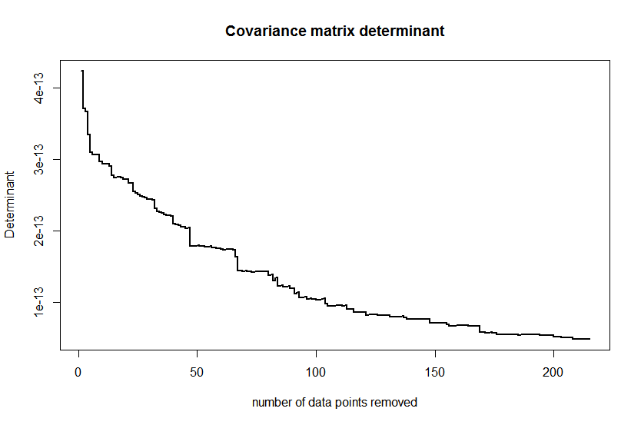
Figure
Step 1: Clean data

Slide 34
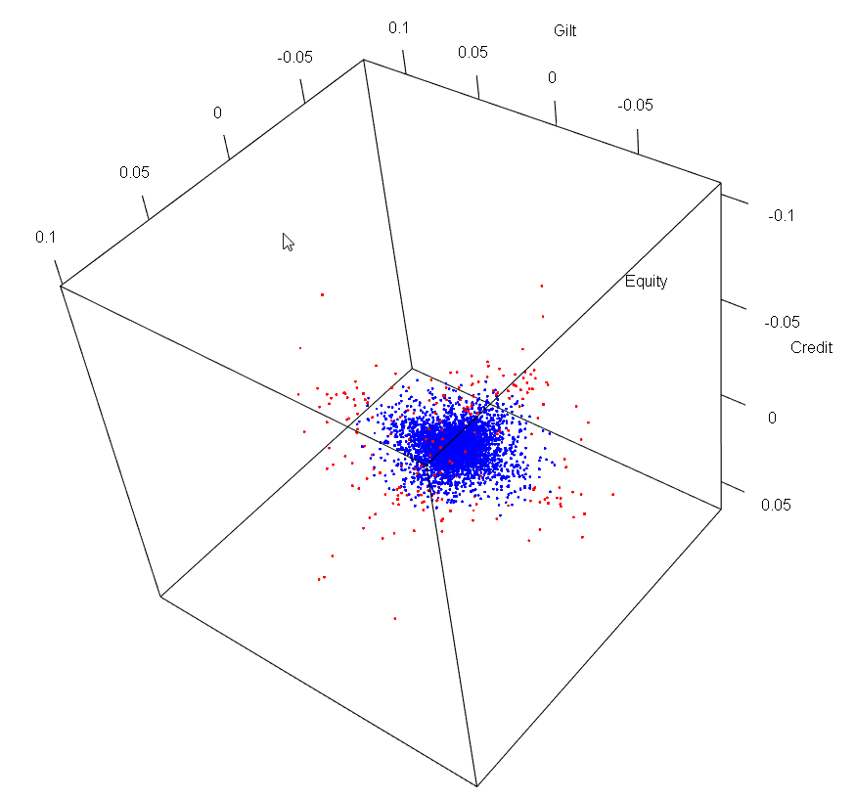
Figure
Step 1: Clean data
3D plot of data points(blue: data-body; red: ‘outliers’)

Slide 35
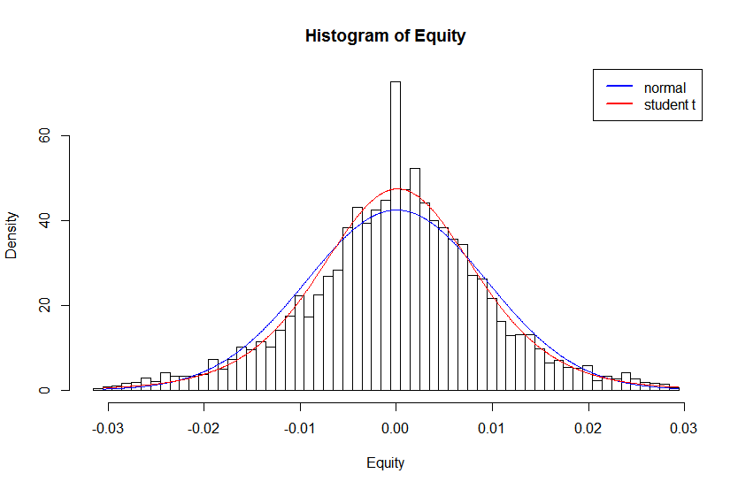
Example 2
After doing the normality test, result rejects the null assumption. While the student t test can’t reject the null assumption.
We still use student t to model for the marginal body data.
Use t-copula to model
for joint distribution.

Slide 36
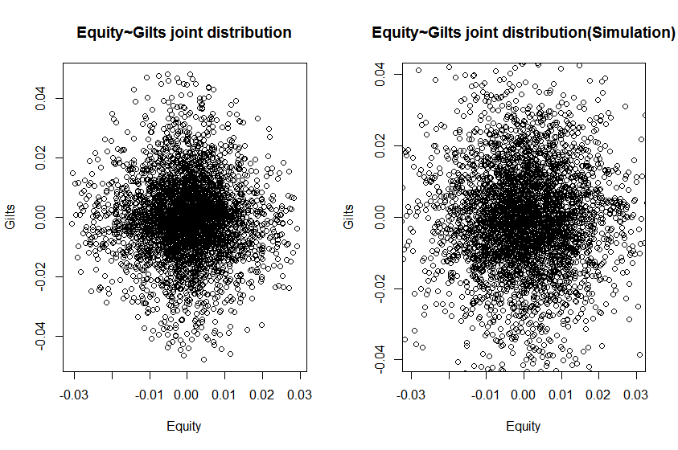
Example 2
Marginal distribution of Equity~Gilts
Simulation data is somewhat more divergent than the initial one.

Slide 37
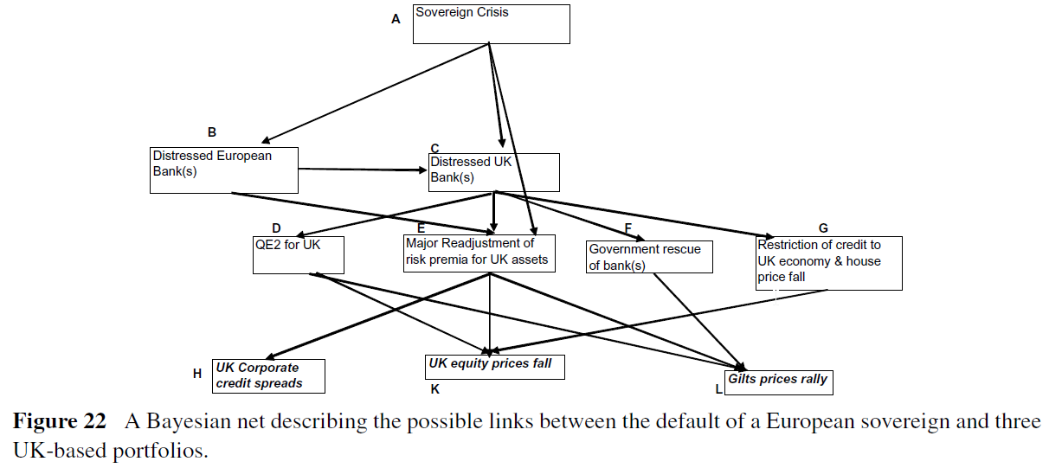
Example 2
Bayesian-net
We have 10 nodes here, thus have 2^10=1024 possible conditions. After calculating the joint probability table, we can get the partial joint probability table contain s only H, K and L.

Slide 38
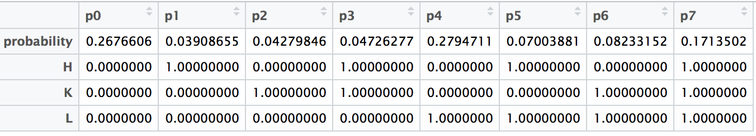
Example 2
Partial joint probability table on H,K,L

Slide 39
Conclusion:
Advantages
Very transparent
Thorough and ‘thoughtful’ sensitivity analysis is possible
Constraints are limited
If it is impossible to provide conditional probability, maximum Entropy for the joint distribution can be employed here

Slide 40
Conclusion:
Disadvantages
Our result somewhat depends on our priori assumption
The utility function is almost linear around 1, we should scale our input to make use of the concave down property of power utility and log utility

